Slide 1


SIMATS ENGINEERIN Saveetha Institute of Medical and Technical Sciences Chennai-602105.
TOC Game: Language Acceptance Race developed to overcome challenges in learning language acceptance, compared with conventional teaching methods, for improved engagement, clarity, and understanding of automata concepts
-Presentation By:
Meheer J[192372327],
D v sai kumar[192372321]
-Supervisor:
Dr.Anitha K, Dr.Latha R

Slide 2
Content
Aim
Objective
Introduction
Algorithm
Flow chart
Pseudocode
Input/output
Results
References

Slide 3
Aim
To provide an interactive and game-based approach instead of conventional lecture methods.
To improve clarity and understanding of automata concepts such as DFA, NFA, and acceptance of strings.
To help learners visualize and simulate automata behavior in a fun and competitive way.
To encourage active participation and reduce passive learning in classrooms.
To simplify complex TOC topics through gamification techniques.
To improve conceptual retention by combining learning with play.

Slide 4
Objective
Aims to overcome challenges of low engagement and abstract understanding in conventional teaching.
The game is designed as a race-based activity, where players check if strings are accepted by given automata.
Promotes active learning, participation, and competition among students.
Provides visual and interactive simulations to understand DFA, NFA, and acceptance conditions.
Enhances clarity, retention, and conceptual understanding of automata theory.
Encourages a student-centered learning environment instead of one-way lectures.

Slide 5
Introduction
One of the most important concepts in TOC is language acceptance, where machines like DFA and NFA decide whether a string belongs to a given language.
Students often face difficulties in understanding these abstract concepts when taught through conventional lecture-based methods.
Traditional methods may result in low engagement, lack of clarity, and poor retention of the subject matter.
Gamification offers a fun, interactive, and motivating approach to learning complex technical topics.

Slide 6
Algorithm
Step 1: Start the game.
Step 2: Input automaton definition (states, alphabet, transition table, start & final states).
Step 3: Each player selects/receives a string.
Step 4: Place token at the start state.
Step 5: For each symbol in the string → move according to transition function.
Step 6: If no transition → string rejected.
Step 7: If end state is final → string accepted; else rejected.
Step 8: Update player’s score based on correctness & speed.
Step 9: Repeat for all strings/players.
Step 10: Declare winner (highest score/fastest).
Step 11: End.

Slide 7
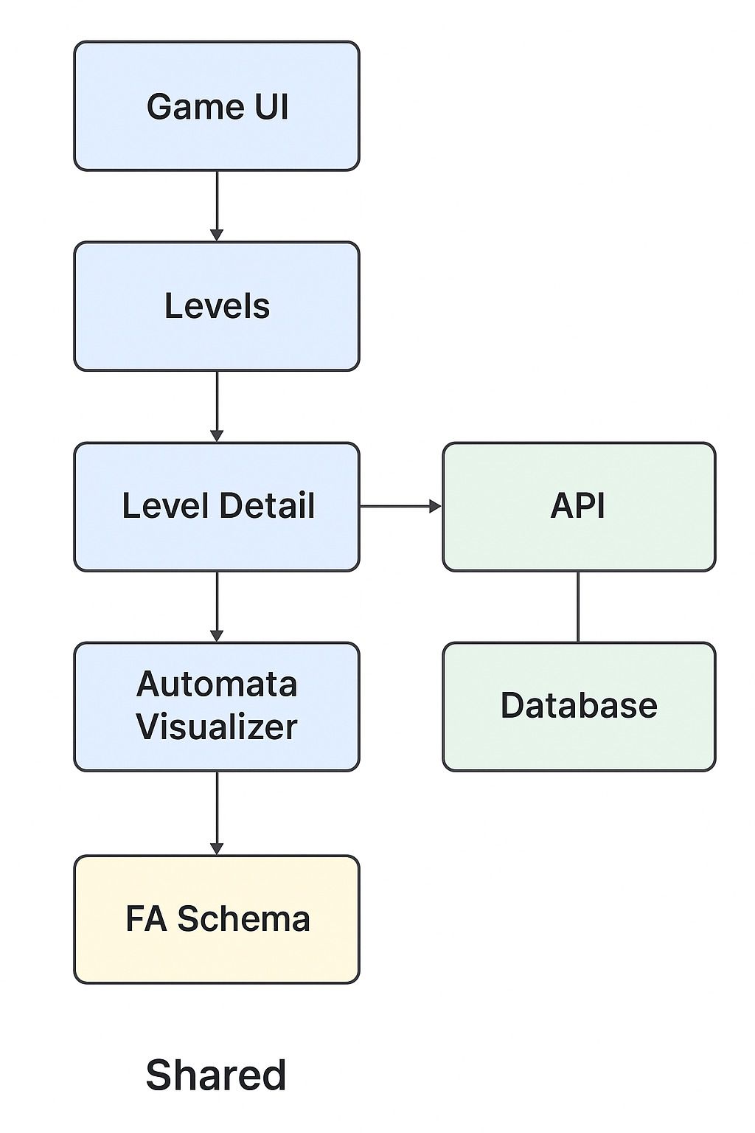
Flow Diagram
Combines UI, database, and visualization for a complete interactive experience.
Levels and Level Detail ensure step-by-step learning with increasing complexity.
API integration makes the system dynamic, scalable, and data-driven.
Automata Visualizer enhances clarity by showing real-time state transitions.
FA Schema standardizes automata representation, ensuring consistency across modules.
Database supports persistence of player progress, scores, and automata data.
Promotes student engagement through interactive gameplay rather than passive learning.
Architecture is modular and reusable, making it easy to extend or update.
Bridges the gap between theory and practice in TOC learning.
Provides a clear structure for integrating game-based learning with automata theory.

Slide 8
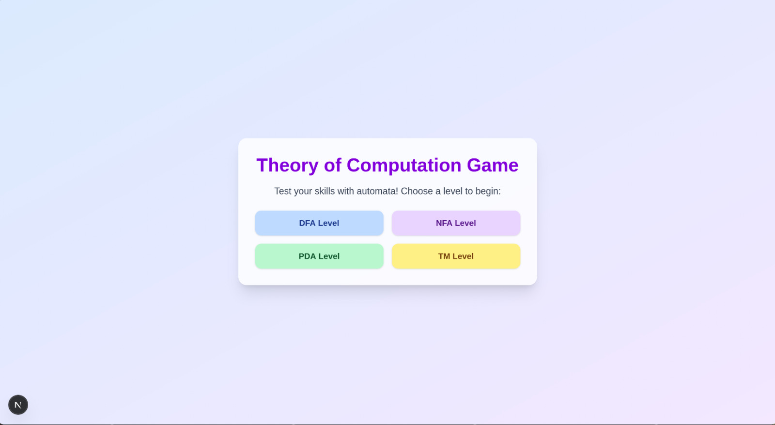
Module 1
Level Design based on FA, PDA and TM challenges.
Each level has a space that we can use to try and complete with an input space
The data then gets stored and analyzed to check if it’s a Goal State on every input
The Status of the game is always displayed, the current state, the Rejected State, and no path state as well!

Slide 9
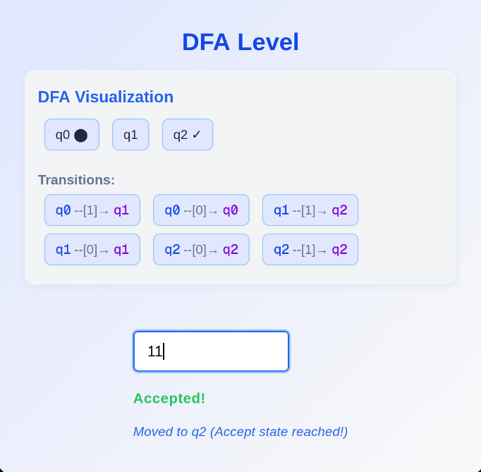
Module 2
Real-time Evaluation with Hints and explanation.
Every level has an input space below which we provide the feedback.
Every input initiates the check to know the current and the goal state.
The current state is checked if it’s the goal state, and if it is, then Accepted is shown, else its shown as Rejected.
If there is no input as such then it shows wrong input, and all this in real time.

Slide 10
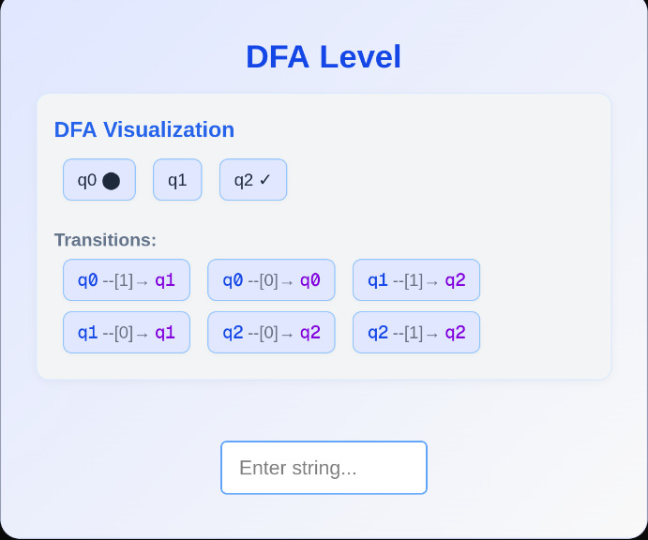
Input/Output

Slide 11
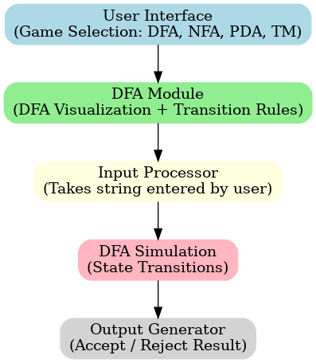
Architecture Diagram

Slide 12
Result Analysis
The game allowed players to simulate DFA/NFA, test input strings, and observe acceptance/rejection visually through the Automata Visualizer.
Game levels with increasing difficulty encouraged step-by-step learning and improved problem-solving skills.
Database and API integration ensured smooth storage and retrieval of levels, automata schemas, and player progress.
Students demonstrated better understanding of abstract TOC concepts compared to conventional teaching methods.
The TOC Game: Language Acceptance Race was successfully developed and implemented to teach automata concepts in an interactive way.

Slide 13
References
Linz, P. (2016). An Introduction to Formal Languages and Automata (6th Edition). Jones & Bartlett Learning.
Sipser, M. (2012). Introduction to the Theory of Computation (3rd Edition). Cengage Learning.
Deterding, S., Dixon, D., Khaled, R., & Nacke, L. (2011). "From Game Design Elements to Gamefulness: Defining 'Gamification'." Proceedings of the 15th International Academic MindTrek Conference.
Kapp, K. M. (2012). The Gamification of Learning and Instruction. Wiley.
ACM Digital Library – Research papers on gamification in computer science education.
Hopcroft, J. E., Motwani, R., & Ullman, J. D. (2007). Introduction to Automata Theory, Languages, and Computation (3rd Edition). Pearson Education.
IEEE Xplore – Articles on automata teaching methods and interactive learning tools.

Slide 14
Thank You
Query Please

